Slide 1






An Introduction to and Motivation for Visualization Research
Data Stories 2018 – Central European University
Johannes Sorger

Slide 2
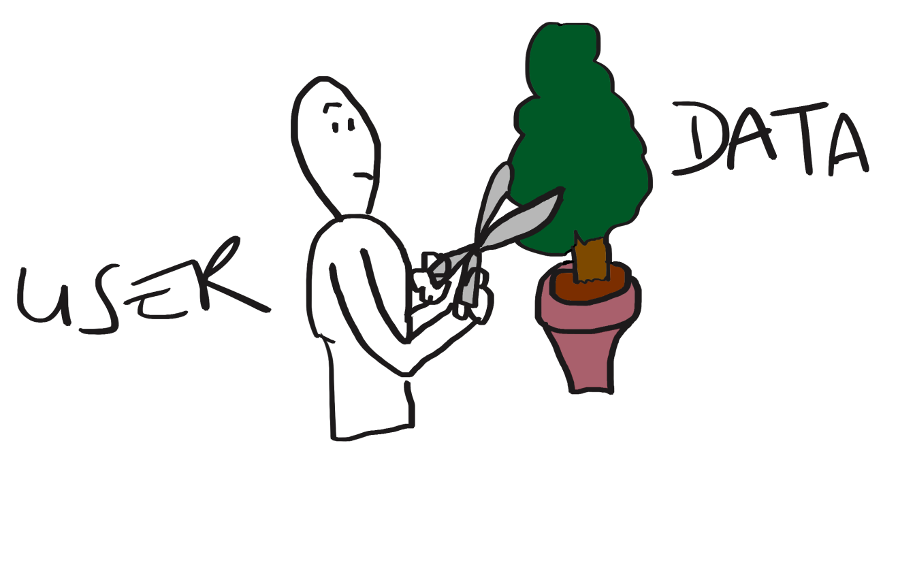
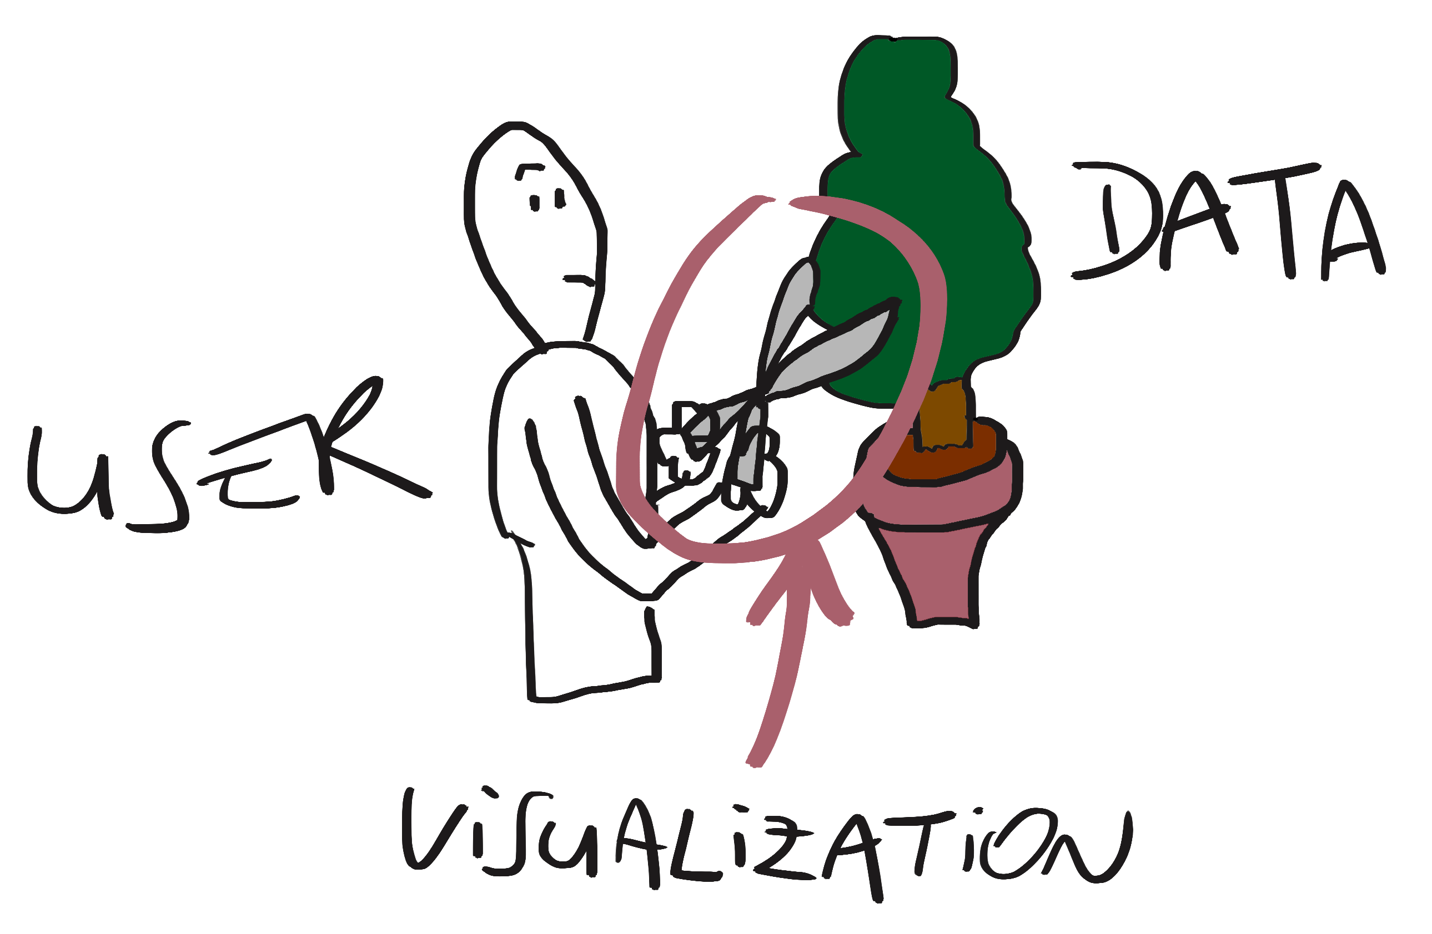

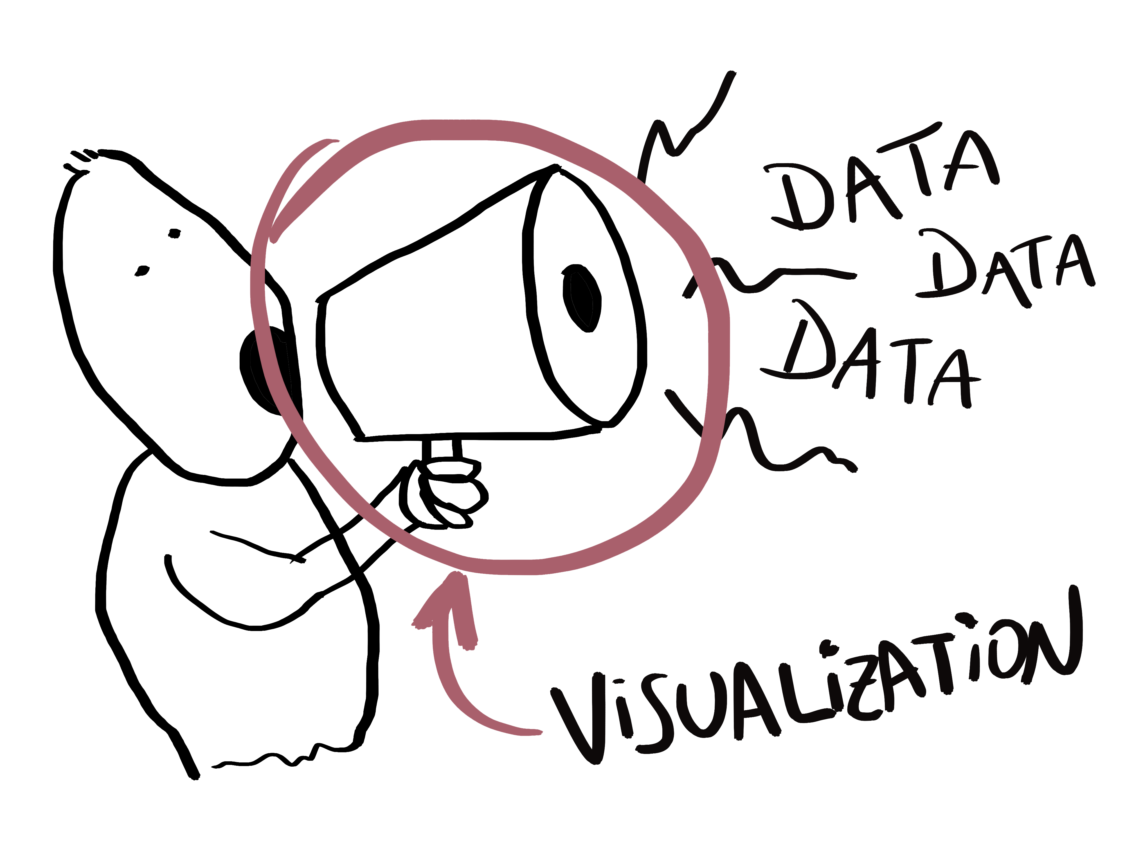

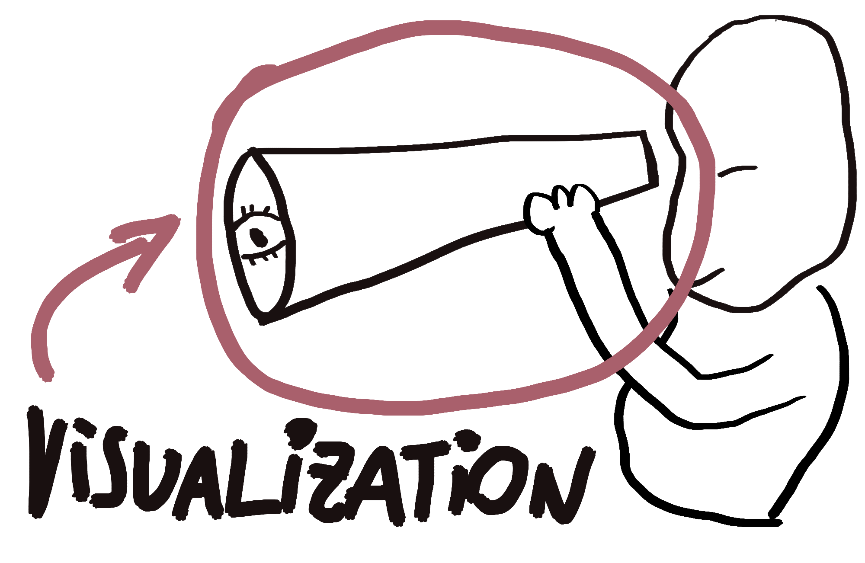
Visualization as a Tool
Represent
Convey
Explore

Slide 3

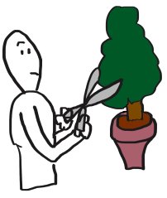
Visualization as a Tool
Visualization approaches
Users tasks
Domain problems
Goal:
understanding potential
develop better tools

Slide 4
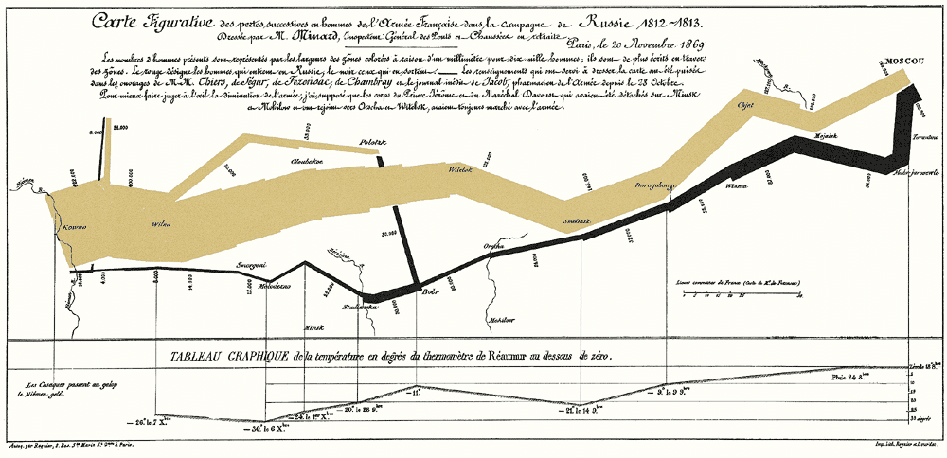
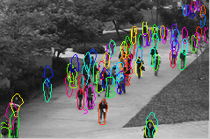
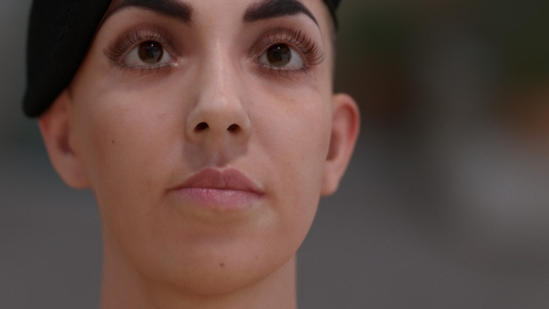
Vis Research / Context
Computer Graphics
Rendering
Visualization
Comp. Vision
[Jimenez et al, 2014, Separable Subsurface Scattering]

Slide 5


Vis Research / Overview
Visualization Categories
Exploration
Story Telling

Slide 6
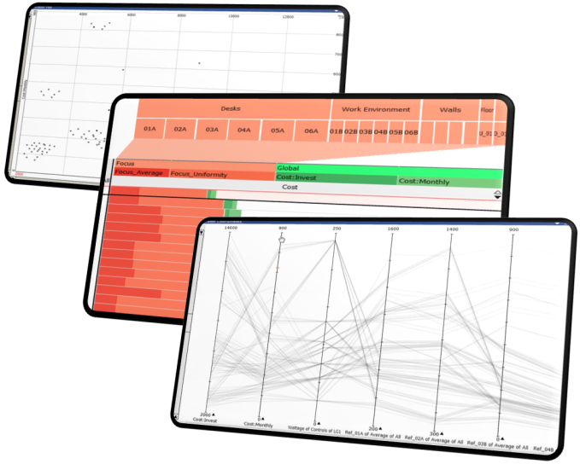
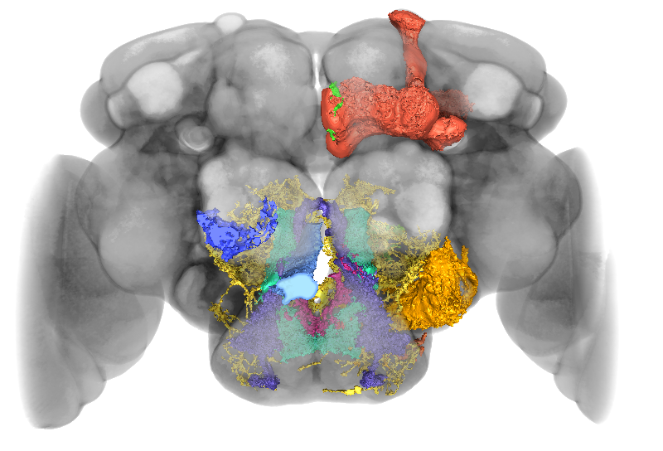
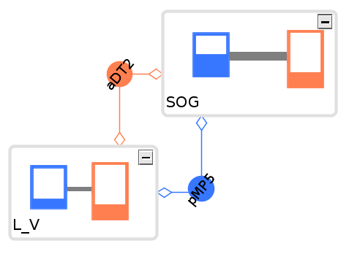

Vis Research / Overview
Visualization Sub Fields
Scientific Visualization
Information Visualization
Visual Analysis
Science &Tech.
Notes:
Biggest conferences & associated journals:
http://ieeevis.org/year/2018/welcome -- https://www.computer.org/web/tvcg
http://www.eurovis2018.org -- http://onlinelibrary.wiley.com/journal/10.1111/(ISSN)1467-8659
Paper collections:
IEEE VIS: http://www.cad.zju.edu.cn/home/vagblog/?page_id=729
Euro vis: http://www.cad.zju.edu.cn/home/vagblog/eurovispapers.html

Slide 7
Vis Research / Goals
Understanding visualization (theory)
Develop novel algorithms (practice)

Slide 8
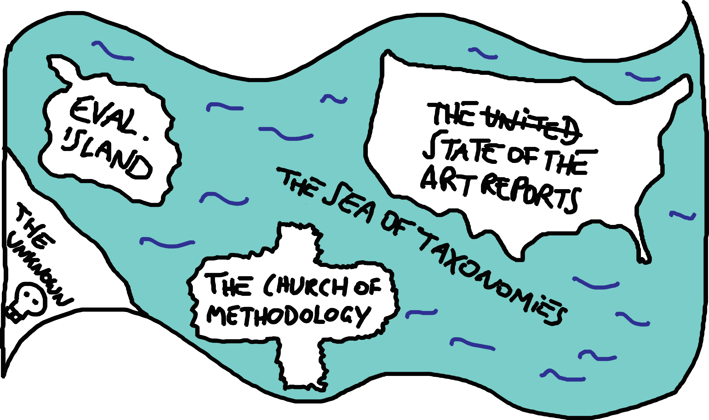
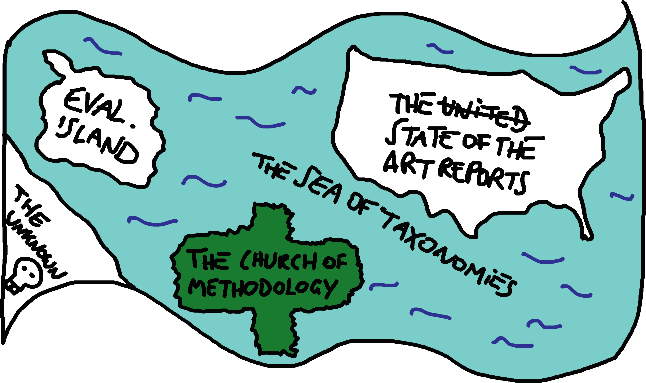
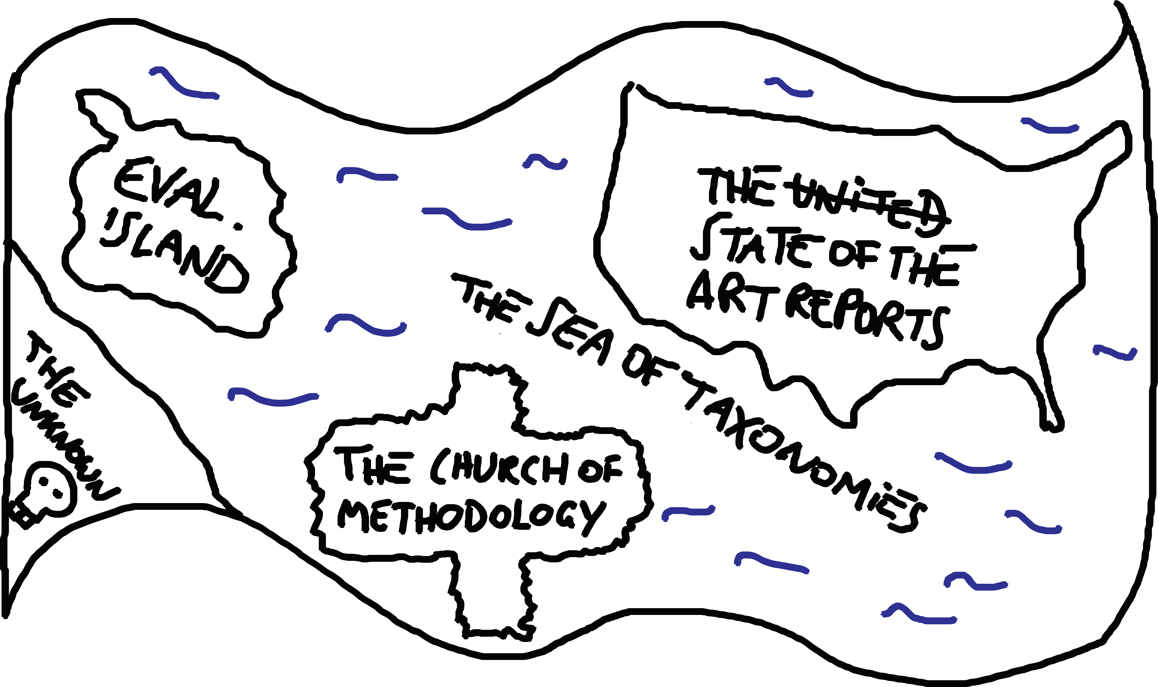
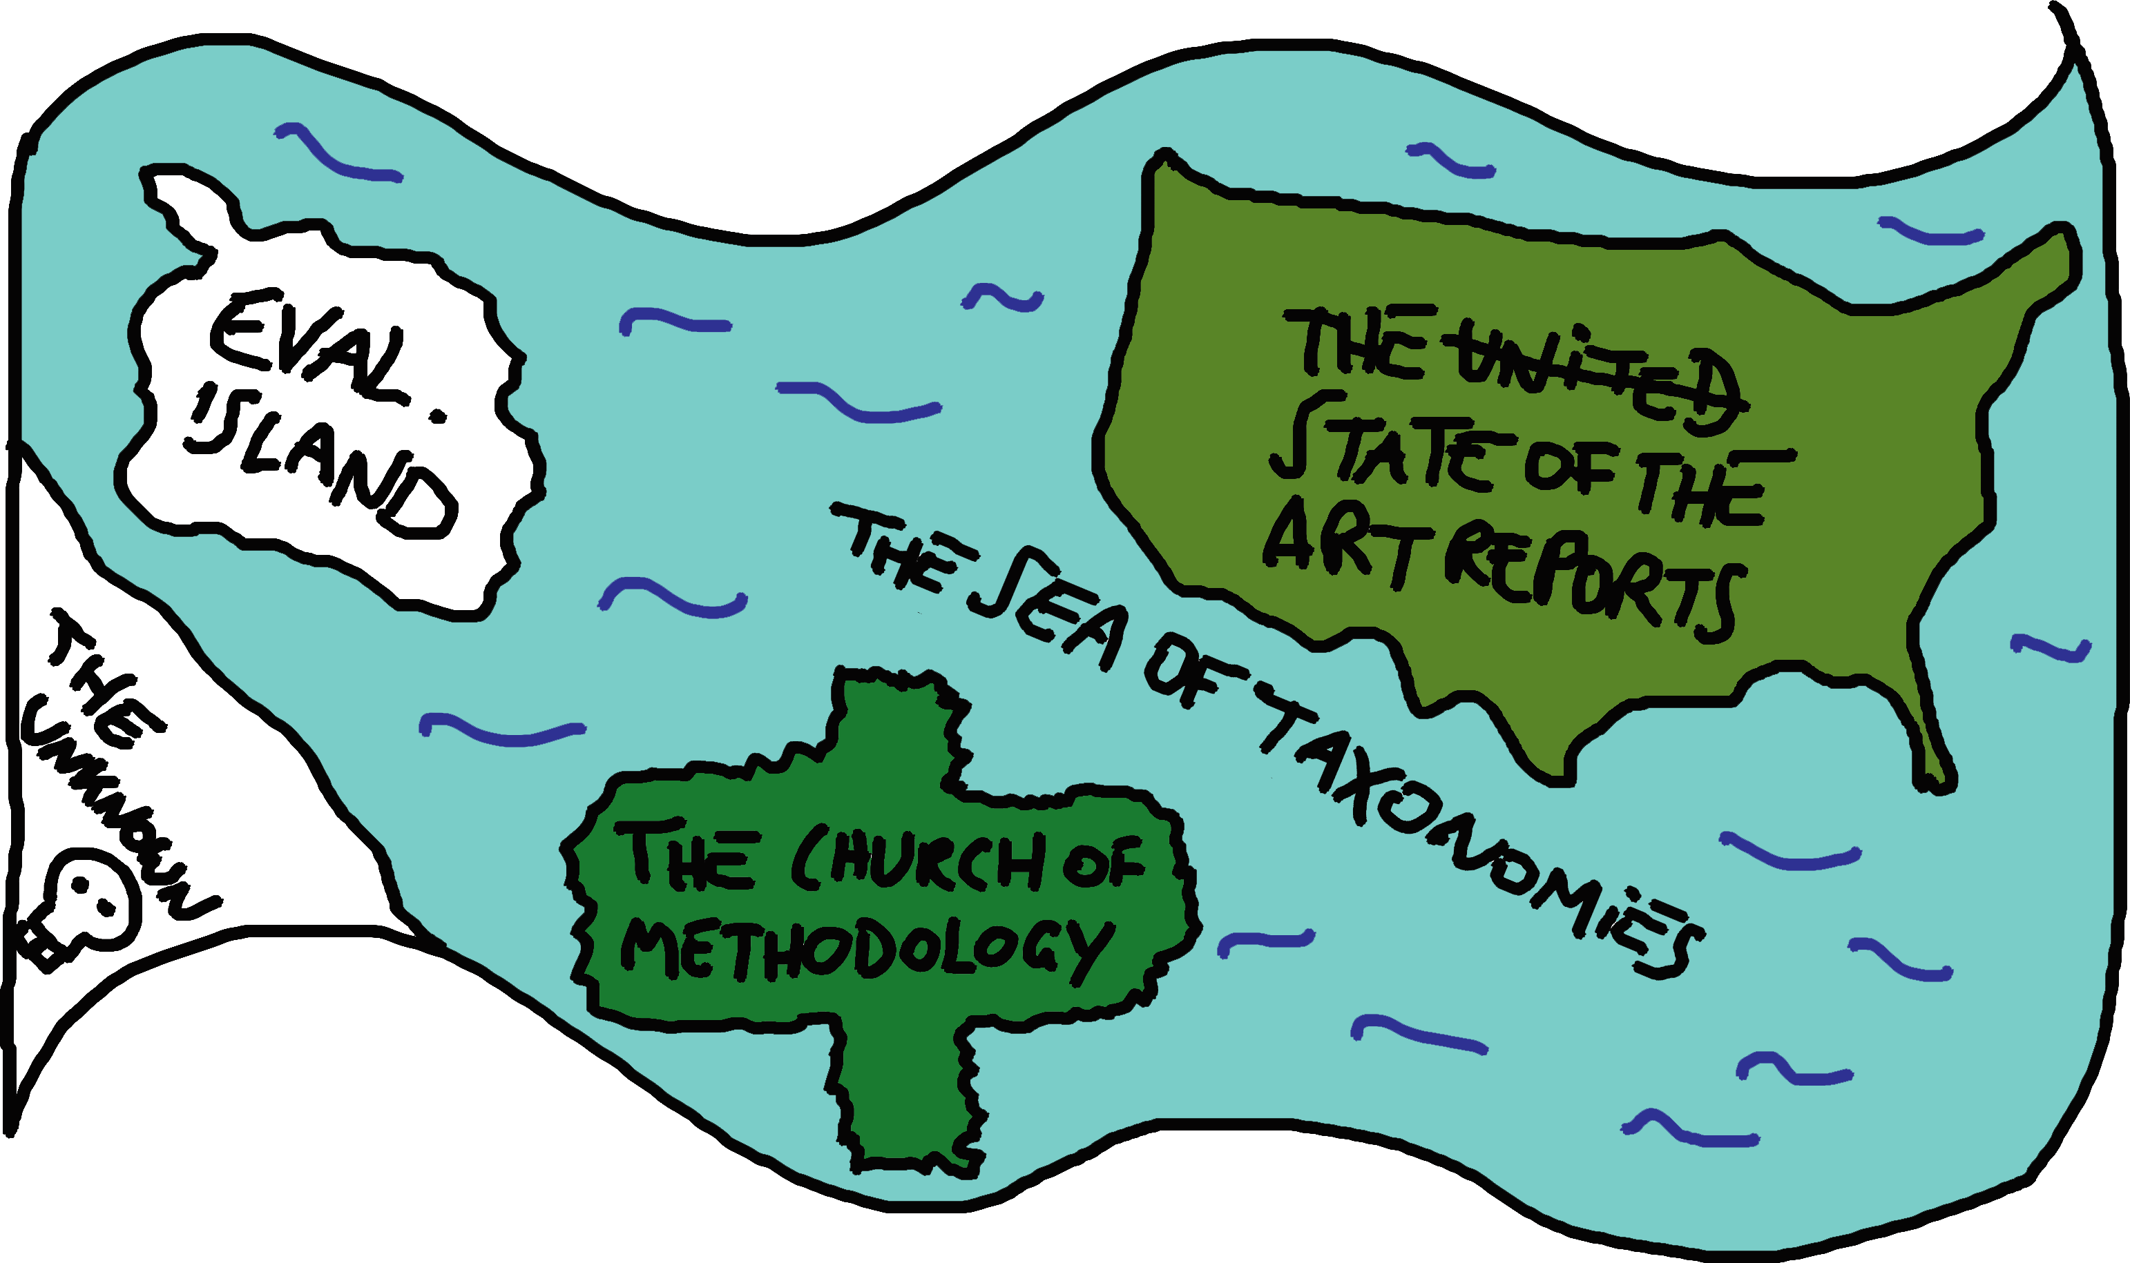
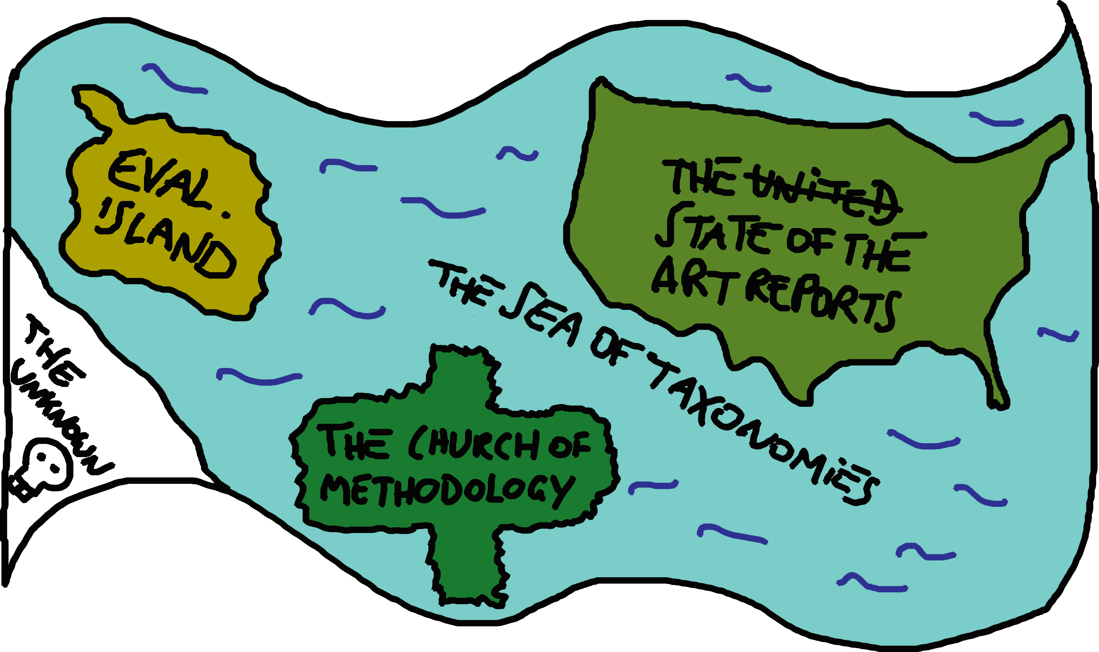

Vis Theory / charting the design space
Taxonomies, typologies, models
Methodologies
State of the art reports
Evaluation

Slide 9
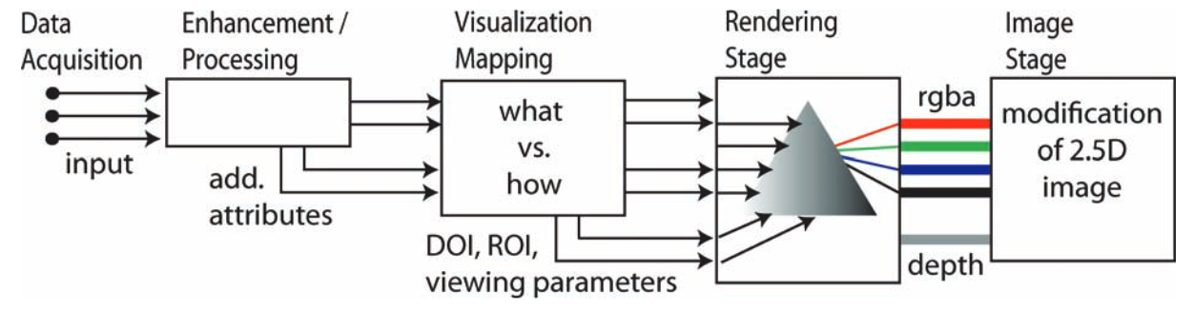
Vis Theory / charting the design space
Taxonomies, typologies, models
Methodologies
State of the art reports
Evaluation
The Visualization Pipeline
[Fuchs, Hauser, 2009, Visualization of Multi-Variate Scientific Data]

Slide 10
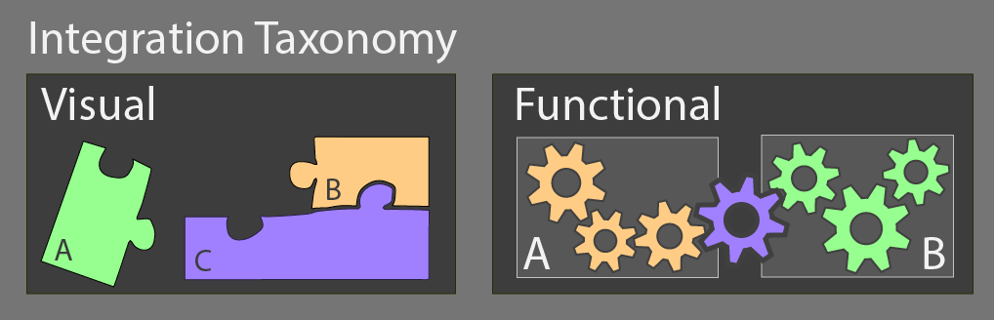
Vis Theory / charting the design space
Taxonomies, typologies, models
panel talks starting at 5:30pm

Slide 11
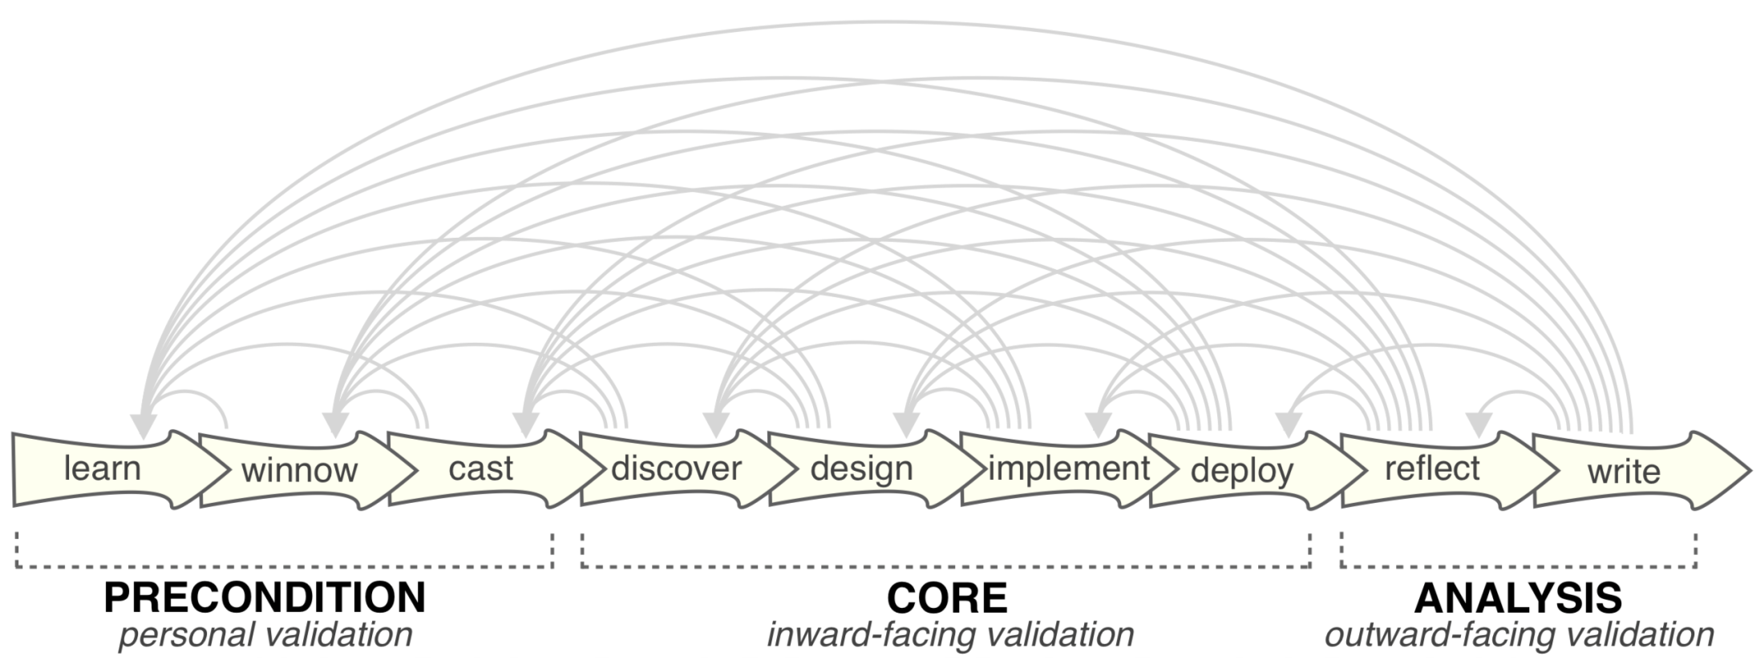
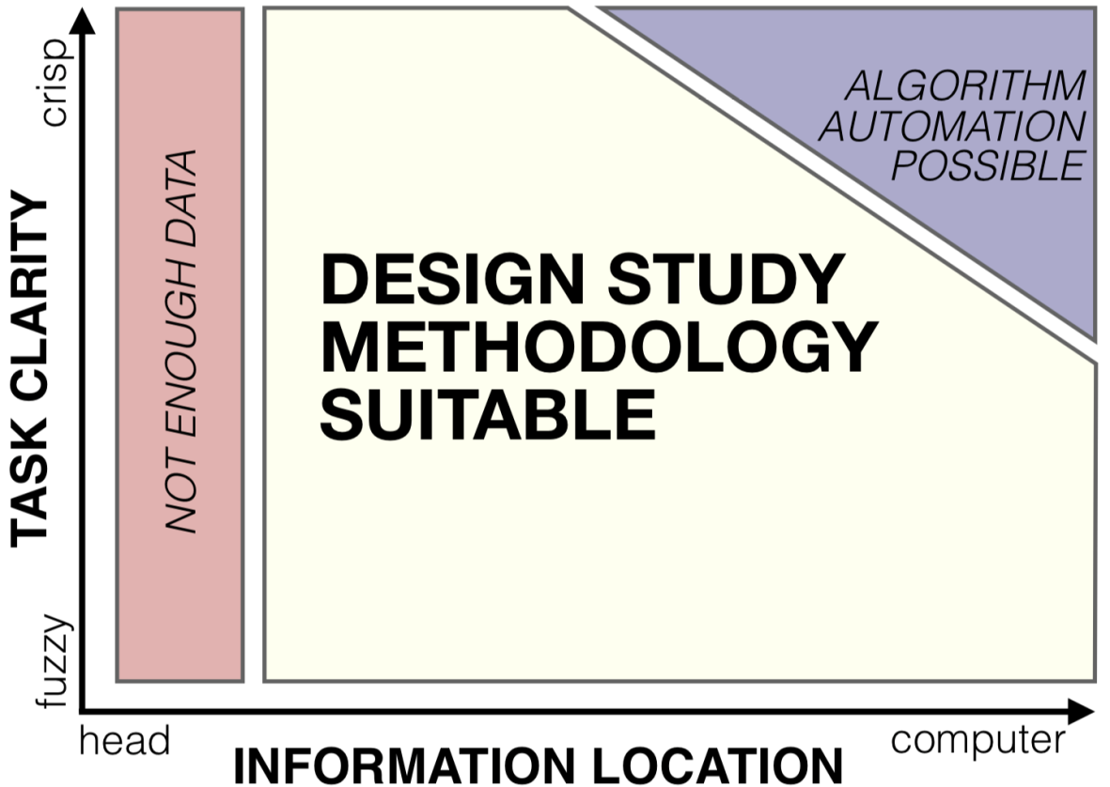
VIS Theory / charting the design space
Taxonomies, typologies, models
Methodologies
State of the art
Evaluation
[Sedlmair et al., 2012, Design Study Methodology: Reflections from the Trenches and the Stacks]

Slide 12
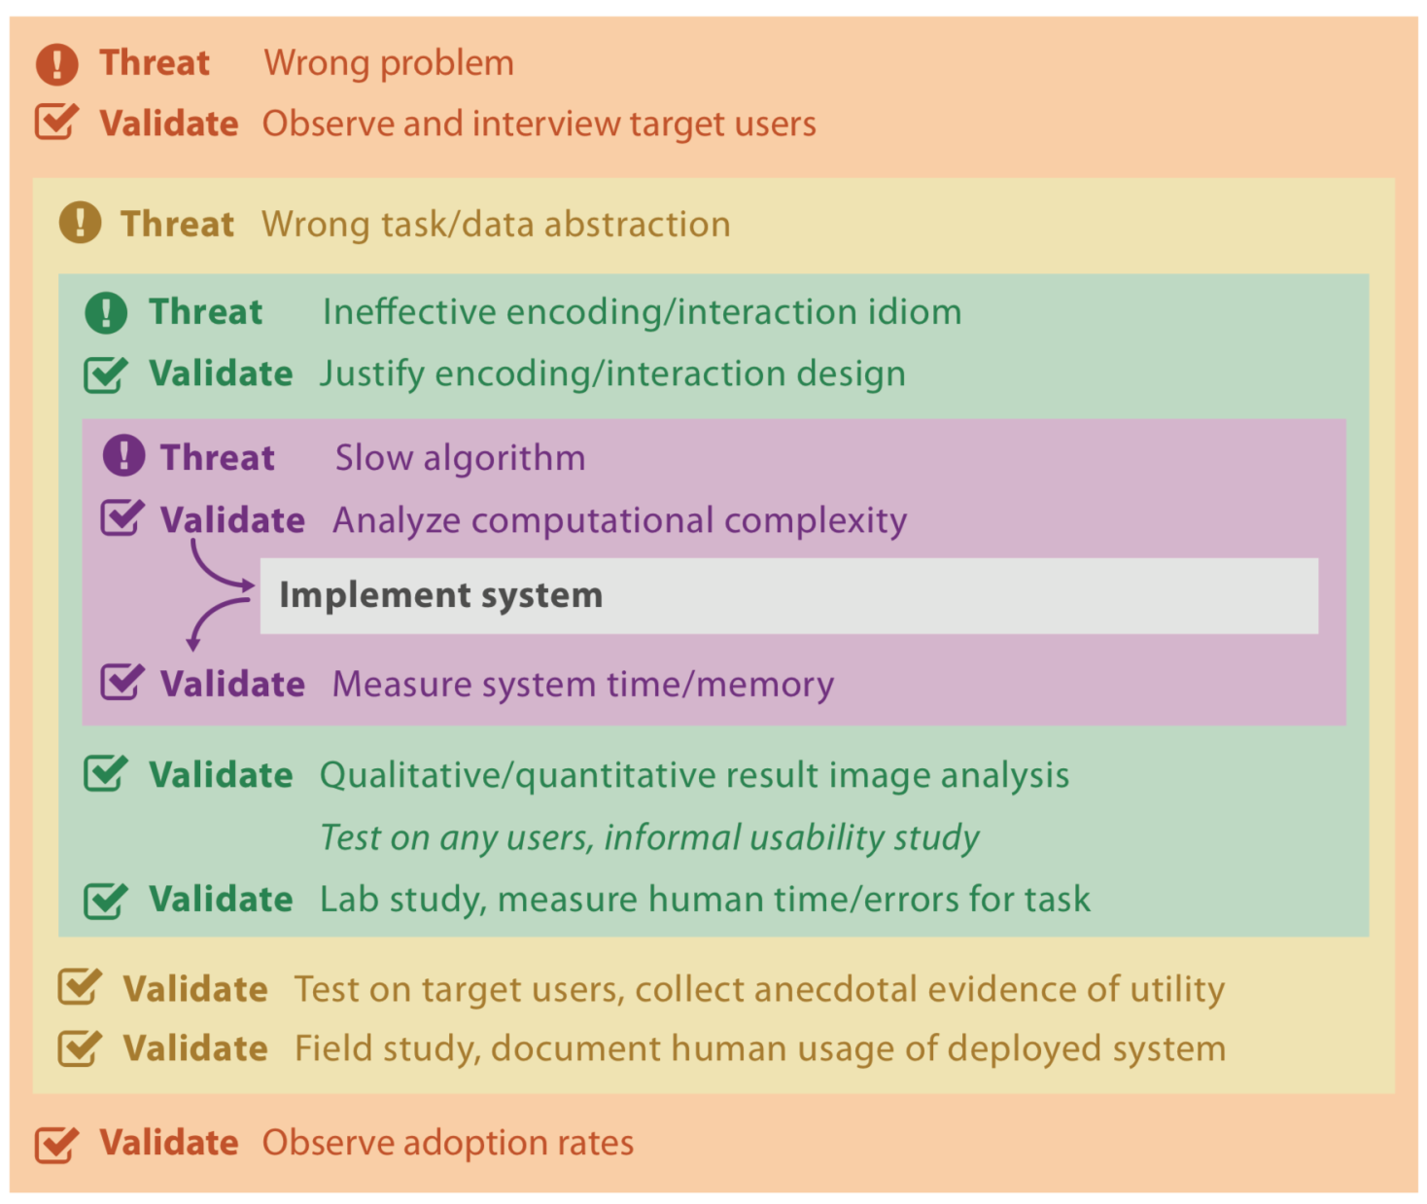
[Munzner, 2009 ,A Nested Model for Visualization Design and Validation]

Slide 13
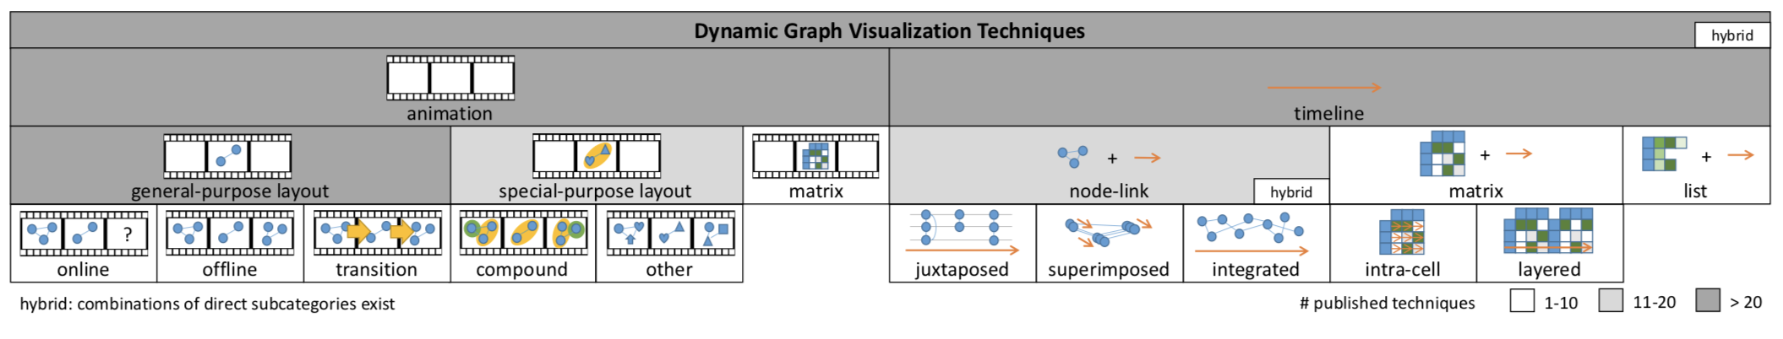
Vis Theory / charting the design space
Taxonomies, typologies, models
Methodologies
State of the art reports
Evaluation
[Beck et al., 2016, A Taxonomy and Survey of Dynamic Graph Visualization]
Notes:
Maybe also interesting:
State-of-the-Art Report in Web-based Visualization http://dx.doi.org/10.1111/cgf.12929
State of the art report archive (computer graphics forum / eurovis):
https://sites.google.com/site/drminchen/cgf-info/cgf-stars

Slide 14
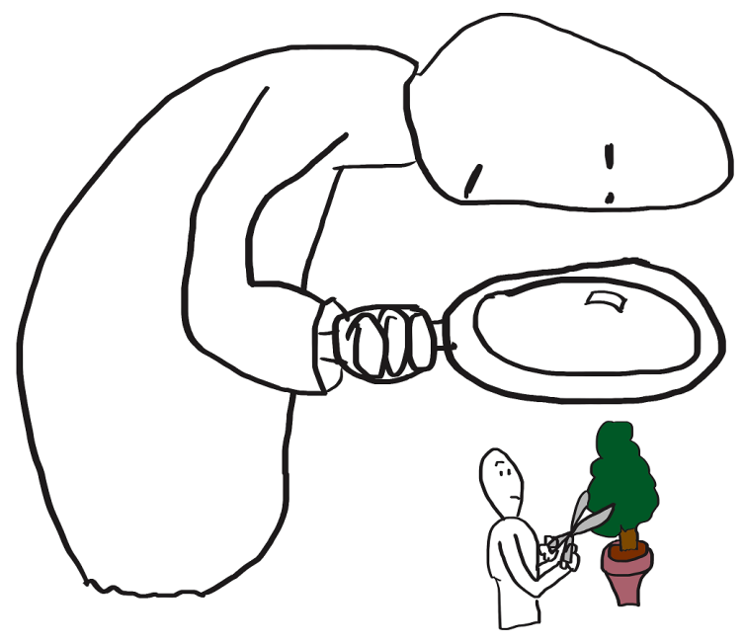
Vis Theory / charting the design space
Taxonomies, typologies, models
Methodologies
State of the art reports
Evaluation

Slide 15

Vis Research / practice
Goal = creating novel expressive & effective techniques and systems
Challenges = limitations of
Computers
Humans
Displays
[Bostok et al., 2011, D³ Data-Driven Documents]

Slide 16
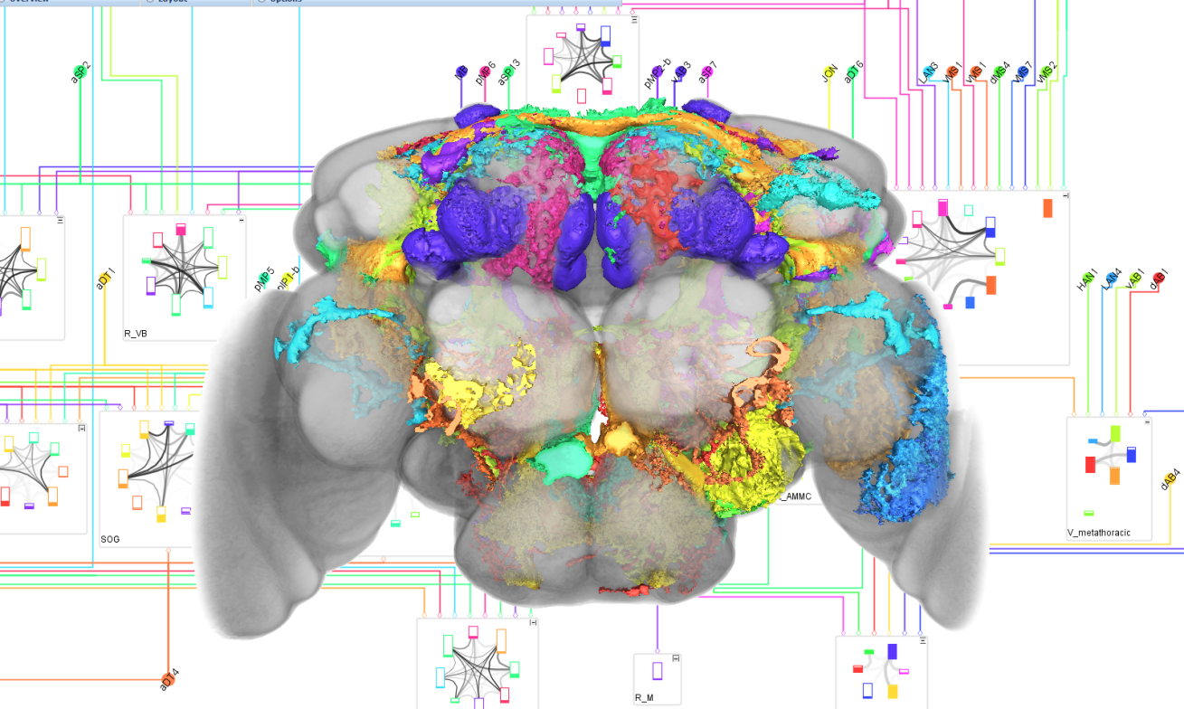
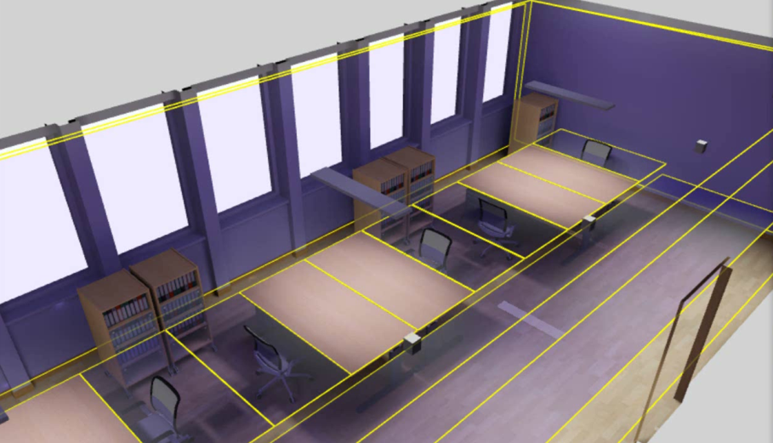
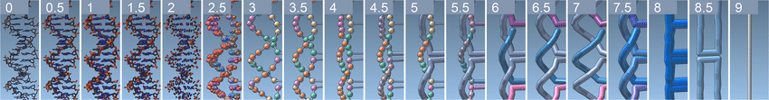
Vis Research / practice
Domain specific problems
=> Design Studies
Notes:
List of my works: https://scholar.google.at/citations?user=84bS-PQAAAAJ&hl=de
https://www.cg.tuwien.ac.at/staff/JohannesSorger.html

Slide 17

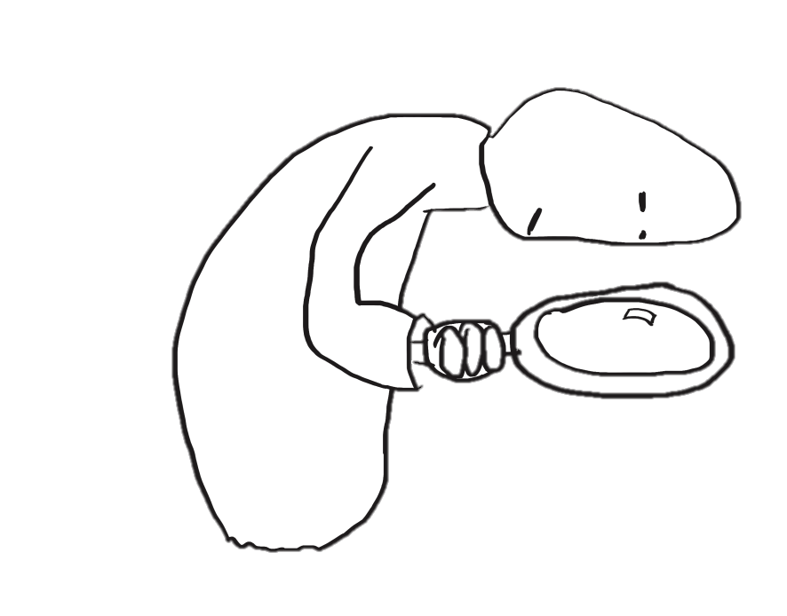
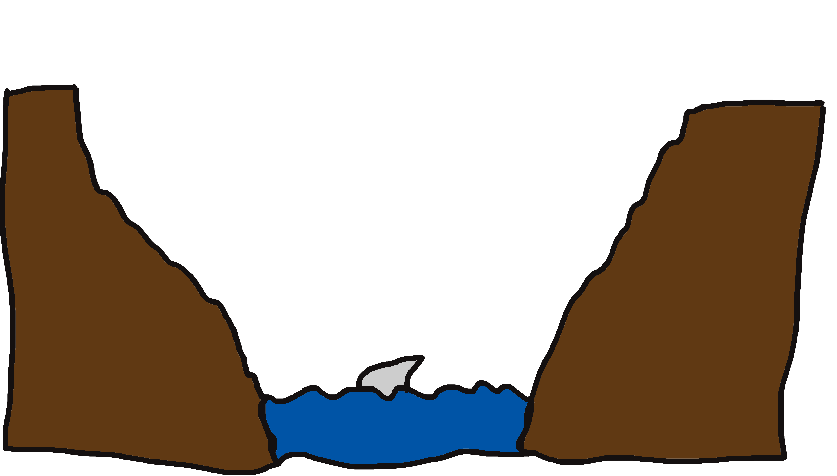
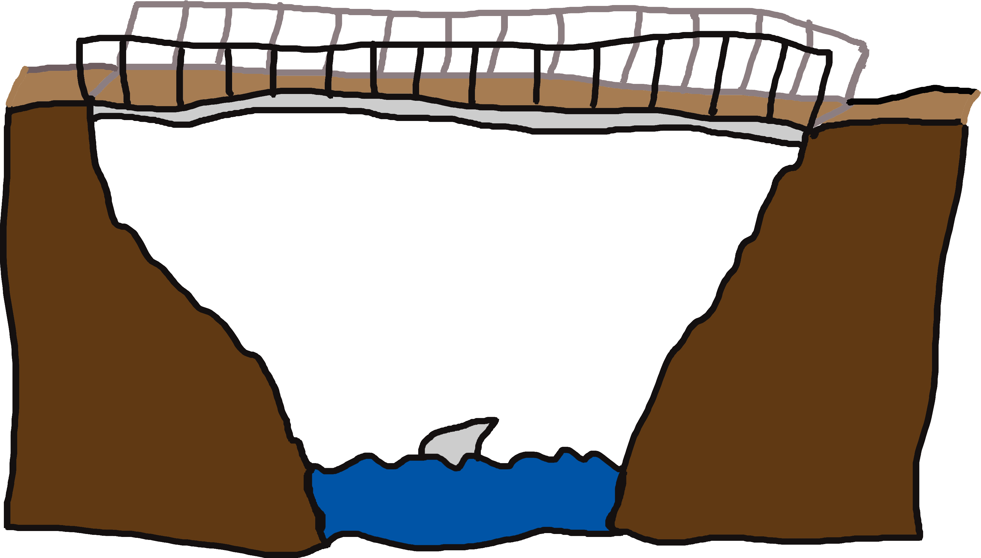
Conclusion
Thank you!
Johannes Sorger
sorger@csh.ac.at
Notes:
very nice collection of further readings / links: available data sets, visualization packages and literature (turorials, books): http://www.cs.ubc.ca/~tmm/courses/533-11/resources.html

Slide 18
Thank you!
Data Stories 2018 – Central European University
Johannes Sorger
sorger@csh.ac.at

Slide 19
Further reading:
Biggest conferences & associated journals:
http://ieeevis.org/year/2018/welcome -- https://www.computer.org/web/tvcg
http://www.eurovis2018.org -- http://onlinelibrary.wiley.com/journal/10.1111/(ISSN)1467-8659
Paper collections:
IEEE VIS: http://www.cad.zju.edu.cn/home/vagblog/?page_id=729
Euro vis: http://www.cad.zju.edu.cn/home/vagblog/eurovispapers.html

Slide 20
Further reading:
State of the art report archive (computer graphics forum / eurovis):
https://sites.google.com/site/drminchen/cgf-info/cgf-stars
Maybe also interesting:
State-of-the-Art Report in Web-based Visualization http://dx.doi.org/10.1111/cgf.12929

Slide 21
Further reading:
List of my work:
https://scholar.google.at/citations?user=84bS-PQAAAAJ&hl=de
https://www.cg.tuwien.ac.at/staff/JohannesSorger.html
very nice collection of further readings / links: available data sets, visualization packages and literature (turorials, books): http://www.cs.ubc.ca/~tmm/courses/533-11/resources.html

